Slide 1
OPERATIONAL RESEARCH

Slide 2
Integer Programming Problem

Slide 3
Types of Integer Programming Problems
Pure Integer Problems
Require that all decision variables have Integer Solutions
Mixed Integer Problems
Require some, but not all, of the decision variables to have integer values in final solutions, whereas others need not have integer values
0 & 1 Integer Problems
Require Integer variables to have value of 0 or 1, such as situations in which decision variables are of YES or NO types

Slide 4
Example – Pure Integer Problem
The jewelry shop in the city specializes in ornaments and manager has planned to limit the use of diamonds to configuration of diamond rings, diamond earrings, and diamond necklaces. The three items require following specifications
Ornament | Diamond
 | ½ Carat | ¼ Carat
Ring | 4 | 6
Earring (Pair) | 3 | 5
Necklace | 10 | 9
Availability | 150 | 160
The jeweler does not want to configure the items more than 50 items. The per unit profit for the rings is Rs. 1500, for earrings is Rs, 2400 and for necklace is Rs.3600. Formulate the problem for Maximizing Profit.

Slide 5
Formulate
Decision Variables:
x1 – Number of diamond rings, x2 – Number of Pair of Earrings, x3 – Number of necklaces
Objective Function:
Max Z = 1500 x1 + 2400 x2 + 3600 x3
Subject to
4 x1 + 3 x2 + 10 x3 <= 150 (1/2 Carat Diamond)
6 x1 + 5 x2 + 9 x3 <= 160 (1/4 Carat Diamond)
X1 + x2 + x3 <= 50 (Total number of items)
x1, x2 & x3 >= 0 and are integers

Slide 6
Methods to Solve the IPP
Cutting Plane Method (also called Gomory’s Cutting Plane method)
Developed by Ralph Gomory
Branch and Bound Method
Developed by A. H. Land and A. G. Doing
Addictive algorithm for Zero and One IPP
Developed by E. Balas

Slide 7
Gomory’s Cutting Plane Method

Slide 8
Gomory’s Cutting Plane Method - Steps
Normalize the Equation
Solve the problem using SIMPLEX method
If all the Basic Variables are Integers, then Optimality has reached. Go to Step 8
In case of Non Integer variables, Find the FRACTIONAL part of f, i.e. bi = [bi] + fi, where bi is Integer part and fi is FRACTIONAL part
Choose the largest fraction amongst various fi, i.e. Max (fi). Treat the constraint corresponding to the maximum fraction as the source row (Equation).
Based on the source equation, Develop an Additional Constraint (Goromy’s Constraint/ fractional cut)
fi = Si – Summation ((fi)(Non-Basic Variables))
Add the fractional cut as last row in latest optimal table and proceed further using DUAL SIMPLEX method and find the new optimum solution. If new solution is Integer then go to Step 8 else go to Step 4
Stop the process and write Optimal solution

Slide 9
Gomory’s Cutting Plane Method - Example
Max Z = 2 x1 + 3 x2
Subject to
2 x1 + 2 x2 <= 7
x1 <= 2
x2 <= 2
x1, x2 >= 0 and are integers
Max Z = 2 x1 + 3 x2 + 0S1 + 0S2 + 0S3
Subject to
2 x1 + 2 x2 + S1 = 7
x1 + S2 = 2
x2 + S3 = 2
x1, x2, S1, S2 & S3 >= 0
Normalized

Slide 10
Gomory’s Cutting Plane Method - Steps
Normalize the Equation
Solve the problem using SIMPLEX method
If all the Basic Variables are Integers, then Optimality has reached. Go to Step 8
In case of Non Integer variables, Find the FRACTIONAL part of f, i.e. bi = [bi] + fi, where bi is Integer part and fi is FRACTIONAL part
Choose the largest fraction amongst various fi, i.e. Max (fi). Treat the constraint corresponding to the maximum fraction as the source row (Equation).
Based on the source equation, Develop an Additional Constraint (Goromy’s Constraint/ fractional cut)
fi = Si – Summation ((fi)(Non-Basic Variables))
Add the fractional cut as last row in latest optimal table and proceed further using DUAL SIMPLEX method and find the new optimum solution. If new solution is Integer then go to Step 8 else go to Step 4
Stop the process and write Optimal solution

Slide 11
Develop Simplex Table 1
2 x1 + 2 x2 + S1 = 7
x1 + S2 = 2
Max Z = 2 x1 + 3 x2 + 0S1 + 0S2 + 0S3
x2 + S3 = 2
C Bi | Cj |  |  |  |  |  | Solution | Ratio
 | Basic Variables
2 3 0 0 0
x1 x2 s1 s2 s3
0
s1
2 2 1 0 0
7
7/2
Least Positive
0
s2
1 0 0 1 0
2
Infinity
0
s3
0 1 0 0 1
2
2
Zj
0 0 0 0 0
Cj - Zj
2 3 0 0 0
Most Positive
For Maximization All Cj – Zj <= 0

Slide 12
Develop Simplex Table 2
2 x1 + 2 x2 + S1 = 7
x1 + S2 = 2
Max Z = 2 x1 + 3 x2 + S1 + S2 + S3
x2 + S3 = 2
C Bi | Cj |  |  |  |  |  | Solution | Ratio
 | Basic Variables
2 3 0 0 0
Least Positive
x1 x2 s1 s2 s3
0
s1
2 0 1 0 -2
3
3/2
0
s2
1 0 0 1 -1
2
2
3
x2
0 1 0 0 1
2
Infinity
Zj
0 3 0 0 3 6
Cj - Zj
2 0 0 0 -3
For Maximization All Cj – Zj <= 0
Most Positive

Slide 13
Develop Simplex Table 3
2 x1 + 2 x2 + S1 = 7
x1 + S2 = 2
Max Z = 2 x1 + 3 x2 + S1 + S2 + S3
x2 + S3 = 2
C Bi | Cj |  |  |  |  |  | Solution | Ratio
 | Basic Variables
2 3 0 0 0
x1 x2 s1 s2 s3
2
x1
1 0 1/2 0 -1
3/2
3/2
0
s2
0 0 -1/2 1 1
1/2
2
3
x2
0 1 0 0 1
2
Infinity
Zj
2 3 1 0 1 9
Cj - Zj
0 0 -1 0 -1
x1 = 3/2
x2 = 2
Z = 9
For Maximization All Cj – Zj <= 0

Slide 14
Gomory’s Cutting Plane Method - Steps
x1 = 3/2
x2 = 2
Z = 9
Normalize the Equation
Solve the problem using SIMPLEX method
If all the Basic Variables are Integers, then Optimality has reached. Go to Step 8
In case of Non Integer variables, Find the FRACTIONAL part of f, i.e. bi = [bi] + fi, where bi is Integer part and fi is FRACTIONAL part
Choose the largest fraction amongst various fi, i.e. Max (fi). Treat the constraint corresponding to the maximum fraction as the source row (Equation).
Based on the source equation, Develop an Additional Constraint (Goromy’s Constraint/ fractional cut)
fi = Si – Summation ((fi)(Non-Basic Variables))
Add the fractional cut as last row in latest optimal table and proceed further using DUAL SIMPLEX method and find the new optimum solution. If new solution is Integer then go to Step 8 else go to Step 4
Stop the process and write Optimal solution

Slide 15
Step 4
In case of Non Integer variables, Find the FRACTIONAL part of f, i.e. bi = [bi] + fi, where bi is Integer part and fi is FRACTIONAL part
x1 = 3/2
x2 = 2
Z = 9
1
fx1 = 1 +
fx2 = 2 + 0
2
Choose the largest fraction amongst various fi, i.e. Max (fi). Treat the constraint corresponding to the maximum fraction as the source row (Equation).
Max (fx1, fx2) i.e. Max (1/2, 0) i.e. 1/2
½ value is of variable x1 hence take the corresponding Row in Last Iteration table to formulate the Equation

Slide 16
Gomory’s Cutting Plane Method - Steps
Normalize the Equation
Solve the problem using SIMPLEX method
If all the Basic Variables are Integers, then Optimality has reached. Go to Step 8
In case of Non Integer variables, Find the FRACTIONAL part of f, i.e. bi = [bi] + fi, where bi is Integer part and fi is FRACTIONAL part
Choose the largest fraction amongst various fi, i.e. Max (fi). Treat the constraint corresponding to the maximum fraction as the source row (Equation).
Based on the source equation, Develop an Additional Constraint (Goromy’s Constraint/ fractional cut)
fi = Si – Summation ((fi)(Non-Basic Variables))
Add the fractional cut as last row in latest optimal table and proceed further using DUAL SIMPLEX method and find the new optimum solution. If new solution is Integer then go to Step 8 else go to Step 4
Stop the process and write Optimal solution

Slide 17
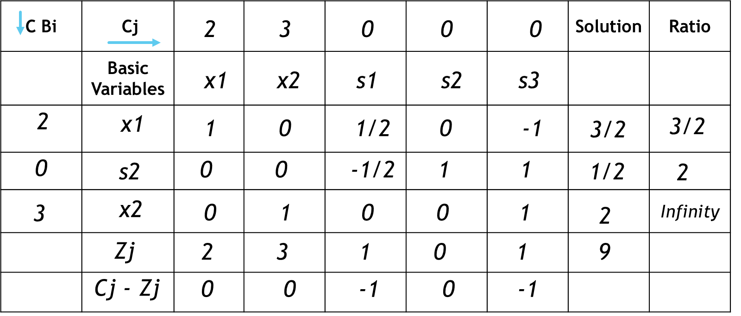
Based on the source equation, Develop an Additional Constraint (Goromy’s Constraint/ fractional cut)
fi = Si – Summation ((fi)(Non-Basic Variables))
½ value is of variable x1 hence take the corresponding Row in Last Iteration table to formulate the Equation

Slide 18
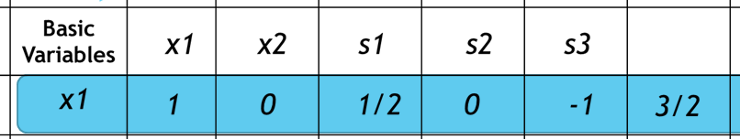
Based on the source equation, Develop an Additional Constraint (Goromy’s Constraint/ fractional cut)
fi = Si – Summation ((fi)(Non-Basic Variables))
½ value is of variable x1 hence take the corresponding Row in Last Iteration table to formulate the Equation
1 x1 + 0 x2 + ½ S1 + 0 S2 - 1 S3 = 3/2

Slide 19
Gomory’s Cutting Plane Method - Steps
Normalize the Equation
Solve the problem using SIMPLEX method
If all the Basic Variables are Integers, then Optimality has reached. Go to Step 8
In case of Non Integer variables, Find the FRACTIONAL part of f, i.e. bi = [bi] + fi, where bi is Integer part and fi is FRACTIONAL part
Choose the largest fraction amongst various fi, i.e. Max (fi). Treat the constraint corresponding to the maximum fraction as the source row (Equation).
Based on the source equation, Develop an Additional Constraint (Goromy’s Constraint/ fractional cut)
fi = Si – Summation ((fi)(Non-Basic Variables))
Add the fractional cut as last row in latest optimal table and proceed further using DUAL SIMPLEX method and find the new optimum solution. If new solution is Integer then go to Step 8 else go to Step 4
Stop the process and write Optimal solution

Slide 20
Add the fractional cut as last row in latest optimal table and proceed further using DUAL SIMPLEX method and find the new optimum solution. If new solution is Integer then go to Step 8 else go to Step 4
1 x1 + 0 x2 + ½ S1 + 0 S2 - 1 S3 = 3/2
Write the Equation in Fractional Form
(1+0) x1 + (0+0) x2 + (0 +½) S1 + (0+0) S2 – (1+0) S3 = (1+1/2)
Re-Write the Equation considering only Fractional Values
½ S1= 1/2
½ S1 = 1/2
½ S1 >= 1/2
Default Constraints are >= and since our Problem is Maximization, The constraints are of <=
Hence, we need to change the sign for above Equation
- ½ S1 <= -1/2

Slide 21
Add the fractional cut as last row in latest optimal table and proceed further using DUAL SIMPLEX method and find the new optimum solution. If new solution is Integer then go to Step 8 else go to Step 4
- ½ S1 <= -1/2
Normalize the above Equation using Gomory’s Slack Variable
- ½ S1 + G1= -1/2
This is called Gomory’s Cutting Plane Equation
Add the Gomory’s Equation in the last Iteration table

Slide 22
Develop Simplex Table 4 – With Gomory Equation
C Bi | Cj |  |  |  |  |  |  | Solution
 | Basic Variables
2 3 0 0 0 0
x1 x2 s1 s2 s3 G1
2
x1
1 0 1/2 0 -1 0
3/2
0
s2
0 0 -1/2 1 1 0
1/2
3
x2
0 1 0 0 1 0
2
0
G1
0 0 -1/2 0 0 1
-1/2
Zj
2 3 1 0 1 0 9
Cj - Zj
0 0 -1 0 -1 0
- ½ S1 + G1= -1/2
All Cj – Zj are <=0 but Since Soln values are not al Integers, use Dual Simplex Method

Slide 23
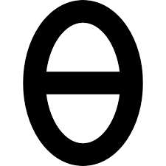
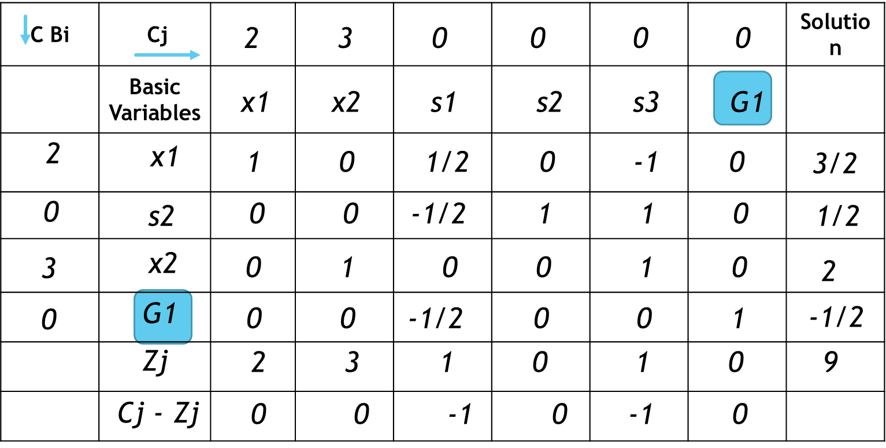
Add the fractional cut as last row in latest optimal table and proceed further using DUAL SIMPLEX method and find the new optimum solution. If new solution is Integer then go to Step 8 else go to Step 4
In DUAL SIMPLEX Method, We need to calculate the value of THITA
To calculate the value of THITA, We need to identify the Least Negative Value in the Solution
Mark the Row with Least Negative Value and use it in THITA Value Calcuation
Cj - Zj
=
(-Ve Row Element)j
Least Negative

Slide 24
Develop Simplex Table 5 – DUAL SIMPLEX
C Bi | Cj |  |  |  |  |  |  | Solution
 | Basic Variables
2 3 0 0 0 0
x1 x2 s1 s2 s3 G1
2
x1
1 0 1/2 0 -1 0
3/2
0
s2
0 0 -1/2 1 1 0
1/2
3
x2
0 1 0 0 1 0
2
0
G1
0 0 -1/2 0 0 1
-1/2
Zj
2 3 1 0 1 0 9
Cj - Zj
0 0 -1 0 -1 0
- - 2 - - -
Select Least Positive Value for identifying Key Row

Slide 25
Develop Simplex Table 6 – DUAL SIMPLEX
C Bi | Cj |  |  |  |  |  |  | Solution
 | Basic Variables
2 3 0 0 0 0
x1 x2 s1 s2 s3 G1
2
x1
1 0 0 0 -1 1
1
0
s2
0 0 0 1 1 -1
1
3
x2
0 1 0 0 1 0
2
0
S1
0 0 1 0 0 -2
1
Zj
2 3 0 0 3 2 8
Cj - Zj
0 0 0 0 -3 -2
x1 = 1
x2 = 2
Z = 8
All the Cj-Zj are <=0 and all Solution Values are +ve

Slide 26
Gomory’s Cutting Plane Method - Steps
Normalize the Equation
Solve the problem using SIMPLEX method
If all the Basic Variables are Integers, then Optimality has reached. Go to Step 8
In case of Non Integer variables, Find the FRACTIONAL part of f, i.e. bi = [bi] + fi, where bi is Integer part and fi is FRACTIONAL part
Choose the largest fraction amongst various fi, i.e. Max (fi). Treat the constraint corresponding to the maximum fraction as the source row (Equation).
Based on the source equation, Develop an Additional Constraint (Goromy’s Constraint/ fractional cut)
fi = Si – Summation ((fi)(Non-Basic Variables))
Add the fractional cut as last row in latest optimal table and proceed further using DUAL SIMPLEX method and find the new optimum solution. If new solution is Integer then go to Step 8 else go to Step 4
Stop the process and write Optimal solution

Slide 27
Branch and Bound Method

Slide 28
Branch and Bound Method
Core Problem
Branch
Root and Branches
Modularity
In Integer Programming
Root – Core Problem
Branches – Sub Problems
Problem 1
Problem 2
Bound
Problem 3
Problem 4
Limits
Upper Bound ( <= )
Lower Bound ( >= )
Upper
Lower
Graphical Method to Solve IPP
<=
>=
0
3
7
10

Slide 29
Branch and Bound Example
1
As Step 1, use 1, 2, 3 and 4 and term is SUB PROBLEM 1
Max Z = 7 x1 + 9 x2
Subject to
- x1 + 3 x2 <= 6
7 x1 + x2 <= 35
(0 <= x1, x2 <= 7)
x1, x2 are integers
Max Z = 7 x1 + 9 x2
Subject to
- x1 + 3 x2 <= 6
7 x1 + x2 <= 35
0 <= x1, x2 <= 7
2
3
4
Use Graphical Method to Solve SUB PROBLEM 1

Slide 30
Branch and Bound Example – Sub Problem 1
1
As Step 1, use 1, 2, 3 and 4 and term is SUB PROBLEM 1
Max Z = 7 x1 + 9 x2
Subject to
- x1 + 3 x2 <= 6
7 x1 + x2 <= 35
(0 <= x1, x2 <= 7)
x1, x2 are integers
Max Z = 7 x1 + 9 x2
Subject to
- x1 + 3 x2 <= 6
7 x1 + x2 <= 35
0 <= x1, x2 <= 7
2
3
4
Find the Values of x2 by assuming values of x1 first constraint
Use Graphical Method to Solve SUB PROBLEM 1
- x1 + 3 x2 = 6
Find the Values of x2 by assuming values of x1 in second constraint
x1 | 0 | 3 | 6
7 x1 + x2 = 35
x2 | 2 | 3 | 4
x1 | 0 | 5 | 2
x2 | 35 | 0 | 21

Slide 31
Branch and Bound Example – Sub Problem 1
Bound – (0 <= x1, x2 <= 7)
Eq 2
Solve the Two Equations
- x1 + 3 x2 = 6
7 x1 + x2 = 35
----------------------------
(- x1 + 3 x2 = 6 ) *7
-7 x1 + 21 x2 = 42
----------------------------
-7 x1 + 21 x2 = 42
7 x1 + x2 = 35
----------------------------
22 x2 = 77
----------------------------
x2 = 77/22
x2 = 7/2
Meeting point of Eq 1 & Eq 2
x2 <= 7
?
Eq 1
0 <= x1
Most feasible
x1 | 0 | 3 | 6
x1 | 0 | 5 | 2
x2 | 2 | 3 | 4
x2 | 35 | 0 | 21

Slide 32
Branch and Bound Example – Sub Problem 1
x2 = 7/2
Use this value of x2 in one of the equation to obtain x1
7 x1 + x2 = 35
7 x1 + 7/2 = 35
x1 = 9/2
Find the Max Z in the most feasible area,
x1, x2 = 0, 0
x1, x2 = 0, 2
x1, x2 = 5, 0
x1, x2 = 9/2, 7/2
Max Z = 7 x1 + 9 x2
x1, x2 = 0, 0
x1, x2 = 0, 2
x1, x2 = 5, 0
x1, x2 = 9/2, 7/2
Eq 2
Z = 0
Z = 18
Z = 35
Z = 63
(9/2, 7/2)
Obtained Solution in Non-Integer of sub Problem 1, hence we need to Branch out further
Eq 1

Slide 33
Tree Diagram of IPP
Solution of SUB PROBLEM 1
x1= 9/2
x2 = 7/2
Z = 63
How to Split the Problem in further Sub problems
Solution of SUB PROBLEM 2
Solution of SUB PROBLEM 3

Slide 34
Branch and Bound Example – Sub Problem 1
As the solution of Sub Problem 1 is non-Integer, take Integer part of the variable and split it into two
x1 = 9/2
Take integer part of it as 4
Upper
Lower
Max Z = 7 x1 + 9 x2
Subject to
- x1 + 3 x2 <= 6
7 x1 + x2 <= 35
0 <= x1, x2 <= 7
x1<=
x1>=
4
4.5
5
Sub Problem 3
Sub Problem 2

Slide 35
Branch and Bound Example – Sub Problem 1
Sub Problem 2
Sub Problem 3
Max Z = 7 x1 + 9 x2
Subject to
- x1 + 3 x2 <= 6
7 x1 + x2 <= 35
x1 >= 5
Max Z = 7 x1 + 9 x2
Subject to
- x1 + 3 x2 <= 6
7 x1 + x2 <= 35
x1 <= 4
Use Graphical Method to Solve SUB PROBLEM 2 and analyze the result for integer values
Use the same values as Sub Problem 1 to plot the graph and use the new constraint
x1 | 0 | 3 | 6
x1 | 0 | 5 | 2
x2 | 2 | 3 | 4
x2 | 35 | 0 | 21

Slide 36
Branch and Bound Example – Sub Problem 2
Most Feasible solution will be at point x1 = 5 & x2 = 0
Eq 2
Eq 3
Find Max Z = 7 x1 + 9 x2
Max Z = 7*5 + 9*0
Max Z = 35
Eq 1
Most feasible

Slide 37
Tree Diagram of IPP
Solution of SUB PROBLEM 1
x1= 9/2
x2 = 7/2
Z = 63
Solution of SUB PROBLEM 2
x1= 5
x2 = 0
Z = 35
Solution of SUB PROBLEM 3
Since solution has all integers, there is no need for further Branching

Slide 38
Branch and Bound Example – Sub Problem 3
Sub Problem 3
Use Graphical Method to Solve SUB PROBLEM 3 and analyze the result for integer values
Max Z = 7 x1 + 9 x2
Subject to
- x1 + 3 x2 <= 6
7 x1 + x2 <= 35
x1 <= 4
Use the same values as Sub Problem 1 to plot the graph and use the new constraint
x1 | 0 | 3 | 6
x1 | 0 | 5 | 2
x2 | 2 | 3 | 4
x2 | 35 | 0 | 21

Slide 39
Branch and Bound Example – Sub Problem 3
Find the Max Z in the most feasible area,
x1, x2 = 0, 0
x1, x2 = 0, 2
x1, x2 = 4, 0
Eq 2
Eq 3
The Point will be
x1 = 4, x2 = 10/3
Max Z = 7 x1 + 9 x2
x1, x2 = 0, 0
x1, x2 = 0, 2
x1, x2 = 4, 0
x1, x2 = 4, 10/3
Solve the Equation 1 & 3
- x1 + 3 x2 = 6
x1 = 4
----------------------------
Replace value of x1 as 4
-4 + 3 x2 = 6
----------------------------
3 x2 = 10
x2 = 10/3
----------------------------
Z = 0
Z = 35
Z = 28
Z = 58
Meeting point of Eq 1 & Eq 3
(4, 10/3)
Eq 1
Obtained Solution in Non-Integer of sub Problem 1, hence we need to go to next steps
Most feasible

Slide 40
Tree Diagram of IPP
Solution of SUB PROBLEM 1
x1= 9/2
x2 = 7/2
Z = 63
Solution of SUB PROBLEM 2
x1= 5
x2 = 0
Z = 35
Solution of SUB PROBLEM 3
x1= 4
x2 = 10/3
Z = 58
Since solution has non-integers, there is need for further Branching
Solution of SUB PROBLEM 4
Solution of SUB PROBLEM 5

Slide 41
Branch and Bound Example – Sub Problem 3
As the solution of Sub Problem 3 is non-Integer, take Integer part of the variable and split it into two
Sub Problem 4
Max Z = 7 x1 + 9 x2
Subject to
- x1 + 3 x2 <= 6
7 x1 + x2 <= 35
x1 <= 4
x2 >=4
x2 = 10/3
Take integer part of it as 3
Upper
Lower
x2<=
x2>=
3
3.3
4
Sub Problem 5
Max Z = 7 x1 + 9 x2
Subject to
- x1 + 3 x2 <= 6
7 x1 + x2 <= 35
x1 <= 4
x2 <= 3
Sub Problem 5
Sub Problem 4

Slide 42
Branch and Bound Example – Sub Problem 4
Max Z = 7 x1 + 9 x2
Subject to
- x1 + 3 x2 <= 6
7 x1 + x2 <= 35
x1 <= 4
x2 >=4
Eq 2
Eq 3
No Optimum Feasible Solution found with this Sub Problem 4
Eq 4
Eq 1

Slide 43
Tree Diagram of IPP
Solution of SUB PROBLEM 1
x1= 9/2
x2 = 7/2
Z = 63
Solution of SUB PROBLEM 2
x1= 5
x2 = 0
Z = 35
Solution of SUB PROBLEM 3
x1= 4
x2 = 10/3
Z = 58
Since solution has non-integers, there is need for further Branching
Solution of SUB PROBLEM 4
No Feasible Solution
Solution of SUB PROBLEM 5

Slide 44
Branch and Bound Example – Sub Problem 5
Max Z = 7 x1 + 9 x2
Subject to
- x1 + 3 x2 <= 6
7 x1 + x2 <= 35
x1 <= 4
x2 <= 3
Find the Max Z in the most feasible area,
x1, x2 = 0, 0
x1, x2 = 0, 2
x1, x2 = 4, 0
x1, x2 = 4, 3
Eq 2
Eq 3
Z = 0
Z = 35
Z = 28
Z = 55
(4/3)
Eq 4
Eq 1
Most feasible

Slide 45
Tree Diagram of IPP
Solution of SUB PROBLEM 1
x1= 9/2
x2 = 7/2
Z = 63
Solution of SUB PROBLEM 2
x1= 5
x2 = 0
Z = 35
Solution of SUB PROBLEM 3
x1= 4
x2 = 10/3
Z = 58
Solution of SUB PROBLEM 4
No Feasible Solution
Solution of SUB PROBLEM 5
x1= 4
x2 = 3
Z = 55
Final Solution of the Problem

Slide 46


